Slide 1
Algorithm design and analysis
SUBMITTED BY:
BHARAT VILAS
2K19/IT/037
as

Slide 2

TOPIC : PHONEBOOK

Slide 3

INTRODUCTUON
Phonebook is a program that help us for storing information or details, about our contact list like name, phone no. ,group of contactand also save it to a text file.
It is used for creating new contacts, deletion of saved contact, displaying saved contacts or saved contacts as our motive.

Slide 4
Program implementation
This program will have several options when we execute this and entered in menu.
It will have 6 options using switch case
Add contact
Delete contact
Search contact
Save to text file
Exit (for closing program )
whenever we choose any above option from menu then it will execute that entered function like if I choose following option:

Slide 5
option 1: then it will take information about new
. contact( name ,phone number and group)
Option 2 : then we can delete any contact that are
. Saved and show their details also
option 3 : we can search added contact by matching
. respective details using conditional
. statement and if details are not matches then
. it will display error.

Slide 6
Option 4 : now we can save contacts that were
. Created into a text file my pc
After execution of any function that we
choose will get an conditional statement that will ask if we want to return main menu or call itself again.
Option 6 : program will close after choosing
. this option

Slide 7
LANGUAGE and CONCEPTS IMPLEMENTED
Whole program will implemented into C++
language.
OOP
Linked list data structure.
Searching and Deletion

Slide 8
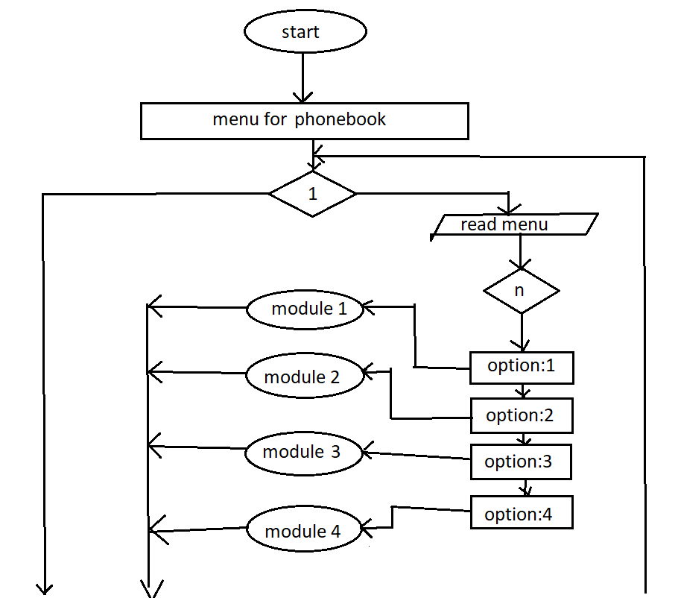
FLOW CHART

Slide 9
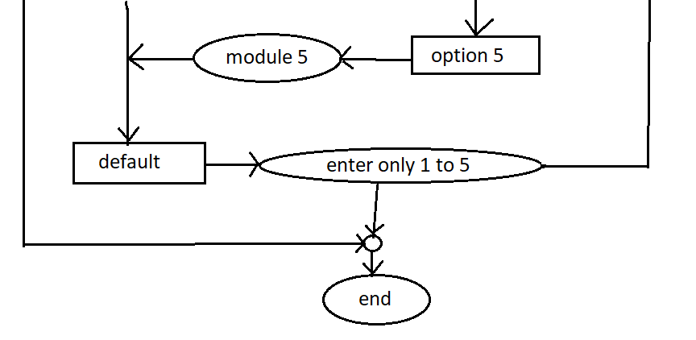
All module are defined in program implementation.

Slide 10
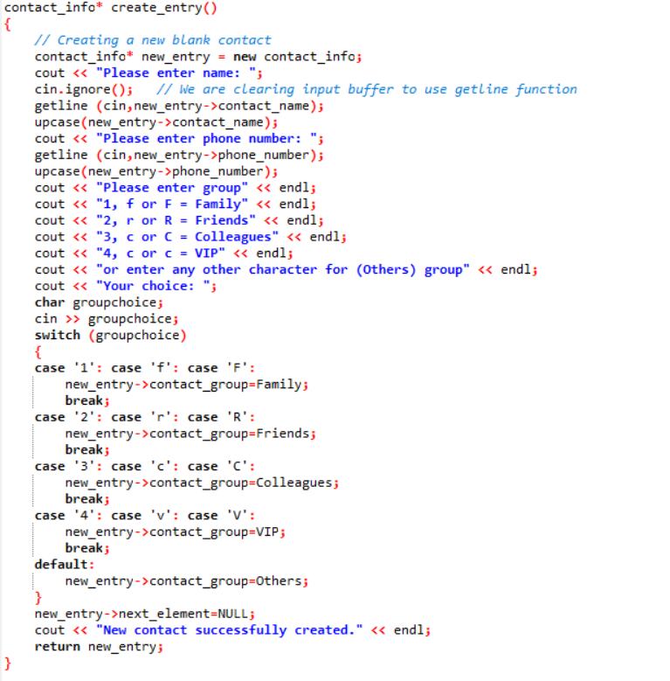
CODE of FUNCTIONS used in PROGRAM

Slide 11
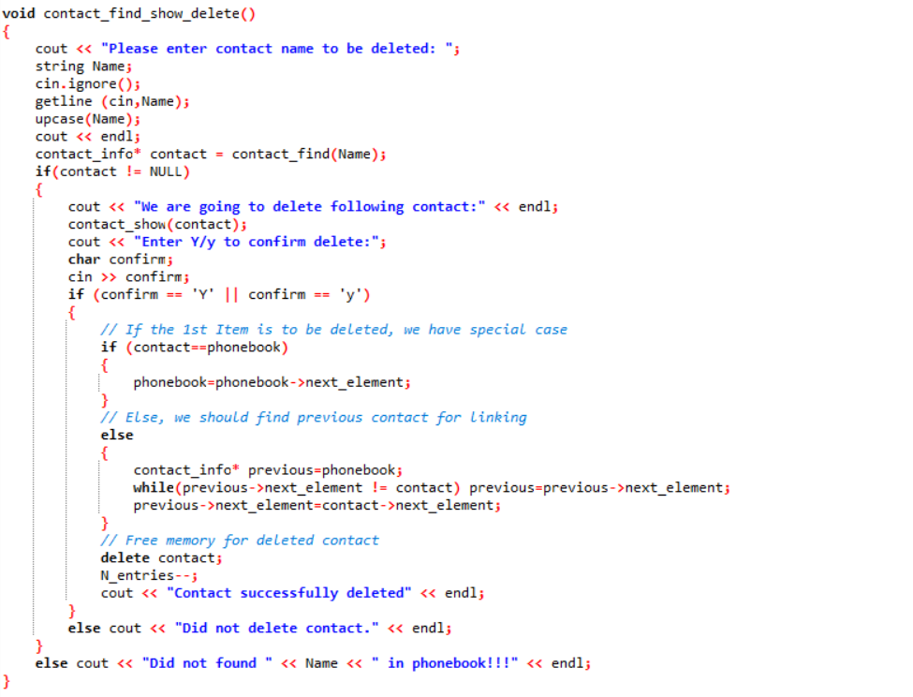

Slide 12
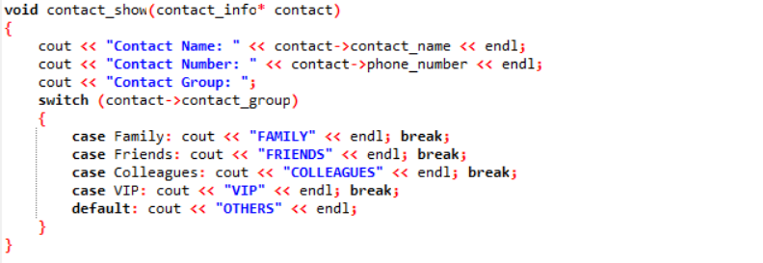
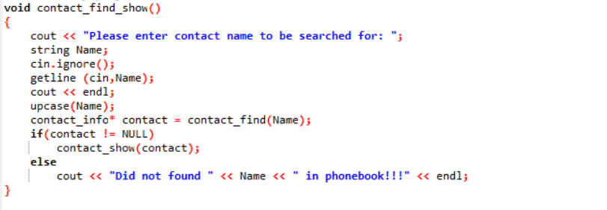

Slide 13
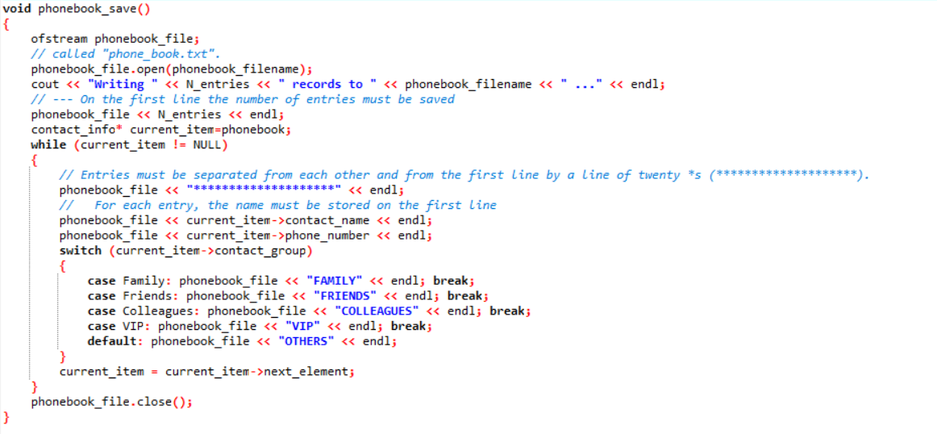

Slide 14
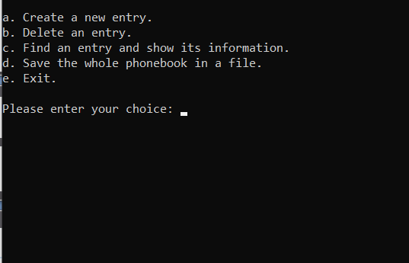
OUT PUT of PROGRAM

